Slide 1

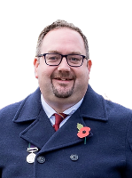
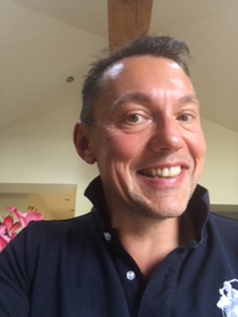
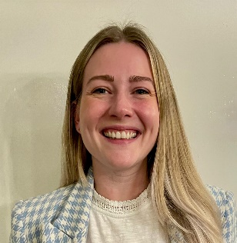
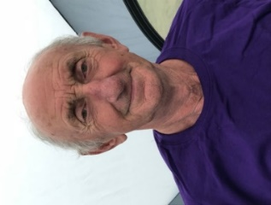
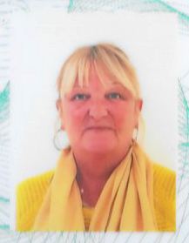
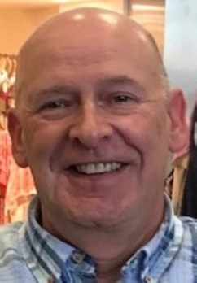
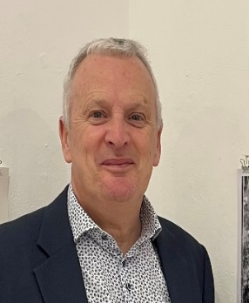
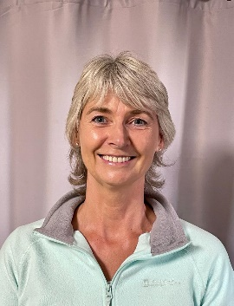
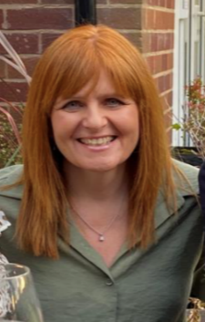
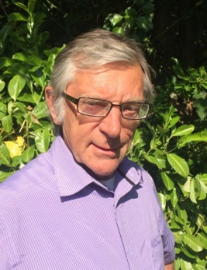

Your Parish Councillor’s
2025
Cllr. Ian Ryder
Chair
07768 598 821
VACANCY
Cllr. Richard Watson
07841592534
Cllr. Katie Garner
07792870852
Cllr. David Ravenscroft
01606 43161
Elaine Hamlett
Parish Clerk
07707627978
Cllr Paul Lee
07789 275881
Cllr. Paul Spare
077433 60044
Cllr. Mark Powell
Vice-Chair
01606 44882
Cllr. Barbara Jones
0787 262 1870
Cllr Wendy Baynes
01606 47085

