Slide 1

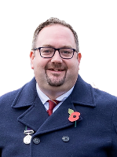
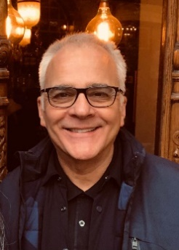
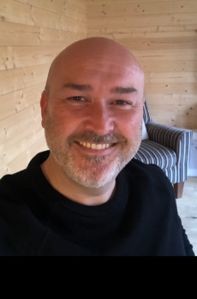
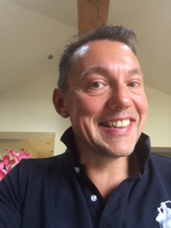
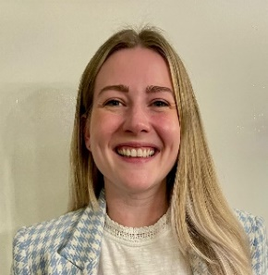
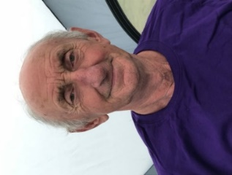
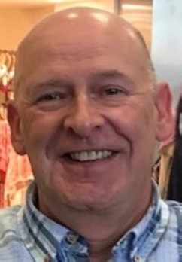
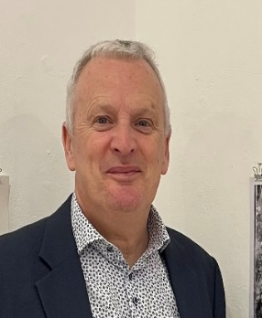
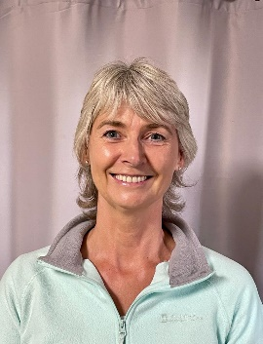
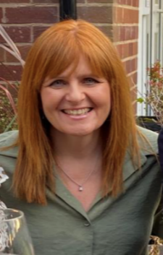
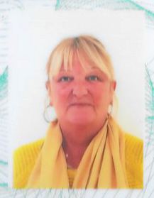
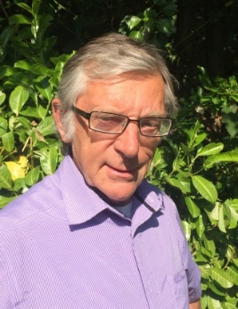
Your Parish Councillor’s
2026
Cllr. Ian Ryder
Chair
07768 598 821
Cllr Rodney Annet
07974926197
Cllr Gareth Entwistle
07590194860
Cllr. Katie Garner
07792870852
Freeman
David Ravenscroft
01606 43161
Cllr. Richard Watson
07841592534
Cllr Paul Lee
07789 275881
Cllr. Paul Spare
077433 60044
Cllr. Mark Powell
Vice-Chair
07831 170459
Cllr. Barbara Jones
0787 262 1870
Cllr Wendy Baynes
01606 47085
Elaine Hamlett
Parish Clerk
07707627978

