Slide 1

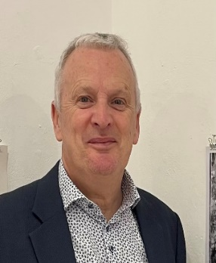
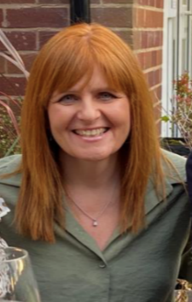
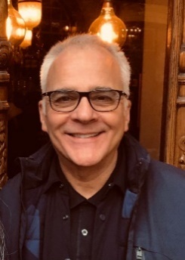
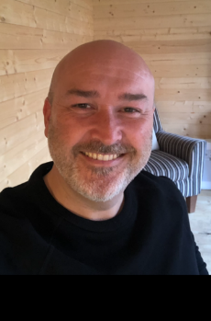
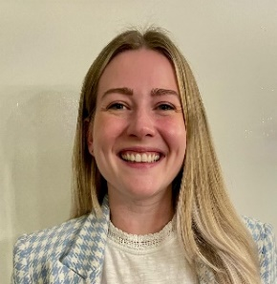
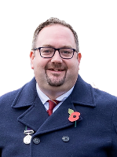
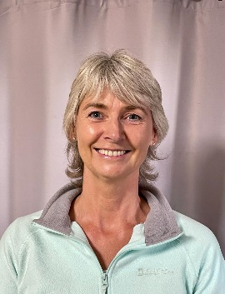
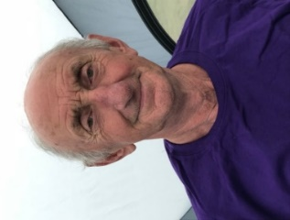
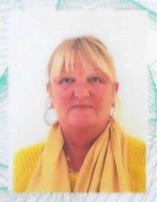
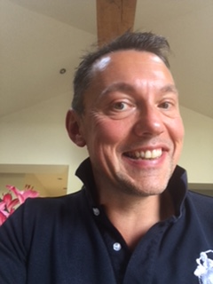
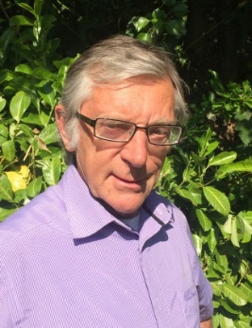
Your Parish Councillor’s
2026/27
Cllr. Mark Powell
Chair
07831 170459
Cllr Wendy Baynes
Vice-Chair
01606 47085
Cllr Rodney Annet
07974926197
Cllr Gareth Entwistle
07590194860
Cllr. Katie Garner
07792870852
Cllr. Ian Ryder
07768 598 821
Cllr. Paul Spare
077433 60044
Cllr. Richard Watson
07841592534
Cllr. Barbara Jones
0787 262 1870
Freeman
David Ravenscroft
01606 43161
Elaine Hamlett
Parish Clerk
07707627978

